Slide 1

Managerial Accounting
Marcelo Ortiz

Slide 2
Analysis of Financial Statements
1. Context and types of analyses
2. Liquidity, Debt, and Asset Mgmt
3. Return and Profitability
4. Stock Market

Slide 3
1. Context and types of analyses
As managers, we can use financial statements to evaluate the financial performance and efficiency of the overall company and different business segments… this analysis is very similar to the approach of an external investor deciding to price our company.
But as managers, we have an advantage relative to external investors: we can get more data, and request reports tailored to specific managerial questions…. That will be the focus on Topics 6 to 9.
Now, we will study a general framework for financial analysis (meaning, using the same data that an external investor would have), trying to get managerial insights from it:
- how is our company growing? Type of assets, funding.
- do we need to change our liquidity/solvency policy?
- are we using our assets efficiently?
- what is driving our profits/losses?
… not only useful for our evaluating our company (or business unit), but also competitors, suppliers, and customers.
2. Liquidity, Debt, and Asset Mgmt
3. Return and Profitability
4. Stock Market

Slide 4
1. Context and type of analyses
Economic Factors
Industry Factors
Company Factors
Interest rate
Unemployment
Inflation
Demand elasticity
Competition
New technologies
Business strategty
Financial situation
2. Balance Sheet
3. Income and Cash Flow Statement
4. Notes and Auditor Reports

Slide 5


1. Context and type of analyses
Business Strategy
Operating Decisions
Transactions
Financial Statements
Product differentiation
Cost differentiation
2. Balance Sheet
3. Income and Cash Flow Statement
4. Notes and Auditor Reports

Slide 6

1. Context and types of analyses
Industry:
Automobile manufacturer and car manufacturer in Europe.
Products:
The group develops vehicles, vehicle software, passenger cars, light commercial vehicle, truck, buses and motorcycles.
It also offers dealer and customer financing, leasing, banking and insurance, and fleet management services. (…)
Brands:
It markets its vehicles under multiple brand names, including Audi, SEAT, Skoda, Bentley, Bugatti, Porsche, Ducati, Volkswagen Commercial Vehicles, Scania, and Cupra.
Location:
It has manufacturing facilities in Salzgitter, Germany and China. Volkswagen has business presence the Americas, Europe, Asia-Pacific and the Middle East. The company is headquartered in Wolfsburg, Germany.
Volkswagen AG
2. Liquidity, Debt, and Asset Mgmt
3. Return and Profitability
4. Stock Market

Slide 7
1. Context and type of analyses
First, we need to know the background (also called "qualitative analysis").
How is the industry evolving in terms of:
- technologies?
- product demand?
- input costs or supply chain?
- the number of competitors?
2. Balance Sheet
3. Income and Cash Flow Statement
4. Notes and Auditor Reports

Slide 8

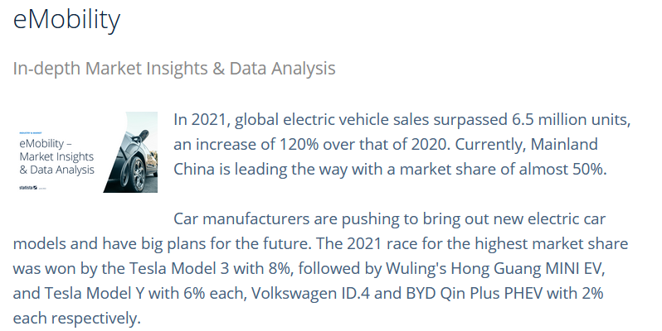
1. Context and type of analyses
+ connected cars.
+ electrical batteries.
+ autonomous self-driven cars.
+ digital sales.
+ sales of pre-owned cars.
Source
2. Balance Sheet
3. Income and Cash Flow Statement
4. Notes and Auditor Reports

Slide 9
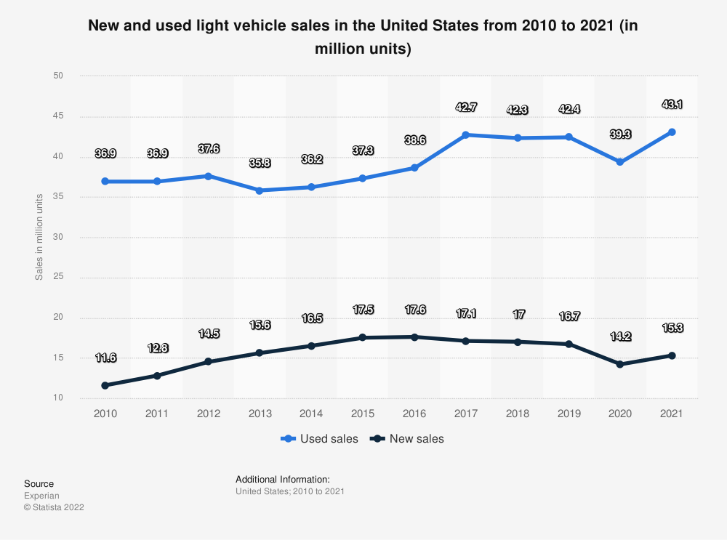
1. Context and type of analyses
Source

Slide 10
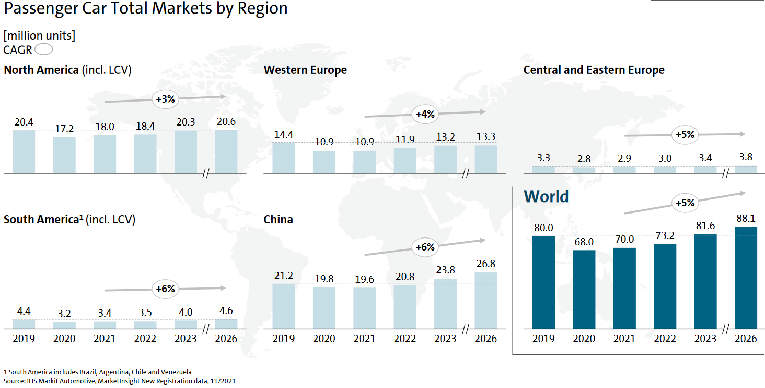
1. Context and type of analyses
Source

Slide 11
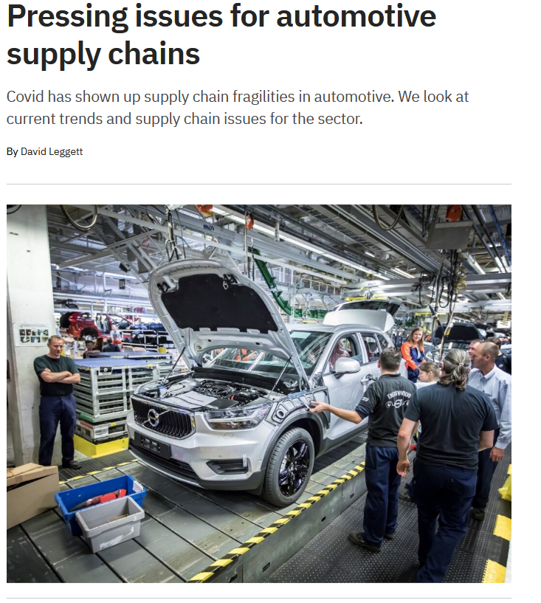
1. Context and type of analyses
Source

Slide 12
Company | Revenue (US$m) | Employees | Market Cap (US$m) | HQ Country
Volkswagen AG | 295,850 | 668,012 | 86,881 | Germany
Toyota Motor Corp | 279,359 | 372,817 | 259,645 | Japan
Mercedes-Benz Group AG | 158,322 | 173,000 | 62,550 | Germany
Bayerische Motoren Werke AG | 131,535 | 118,909 | 53,375 | Germany
Honda Motor Co Ltd | 129,557 | 204,035 | 45,704 | Japan
General Motors Co | 127,004 | 157,000 | 52,111 | United States of America
SAIC Motor Corp Ltd | 120,908 | 207,246 | 28,038 | China
Hyundai Motor Co | 102,797 | 70,032 | 36,918 | South Korea
China FAW Group Co Ltd | 101,073 | 120,000 |  | China
Nissan Motor Co Ltd | 75,001 | 134,111 | 15,792 | Japan
Renault SA | 54,645 | 156,466 | 8,686 | France
Tesla Inc | 53,823 | 99,290 | 880,192 | United States of America
AB Volvo | 43,394 | 85,329 | 36,728 | Sweden
Tata Motors Ltd | 37,714 | 73,608 | 20,165 | India
Mazda Motor Corp | 27,779 | 48,750 | 5,251 | Japan
Jaguar Land Rover Automotive Plc | 25,306 | 36,531 |  | United Kingdom
Subaru Corp | 24,433 | 36,910 | 13,272 | Japan
Great Wall Motor Co Ltd | 21,148 | 77,934 | 36,303 | China
Dongfeng Motor Group Co Ltd | 17,521 | 122,061 | 5,949 | China
Guangzhou Automobile Group Co Ltd | 11,733 | 96,989 | 19,157 | China
VDL Groep BV | 5,187 | 15,734 |  | Netherlands
1. Context and type of analyses
Source

Slide 13
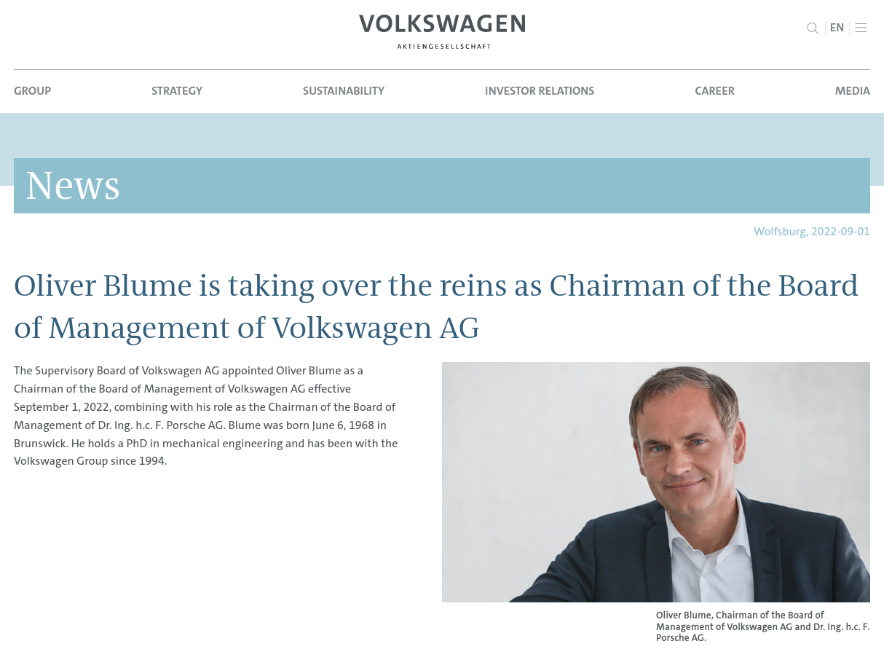
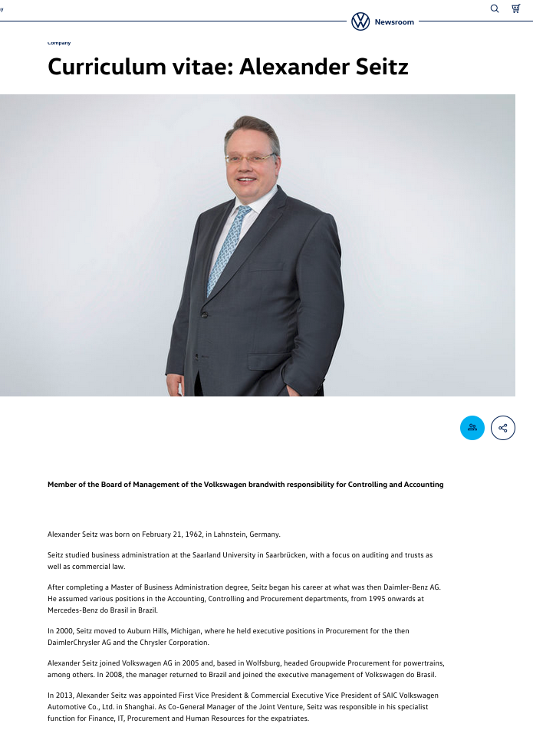
1. Context and type of analyses
Once we know about the industry, we move to know about the company:
Who runs the company?
- Reputation
- Experience
- Connections or Human Capital
- Profile: tech, manager, seller.
What is the business strategy?
What are the main product lines?
Where are they located?

Slide 14
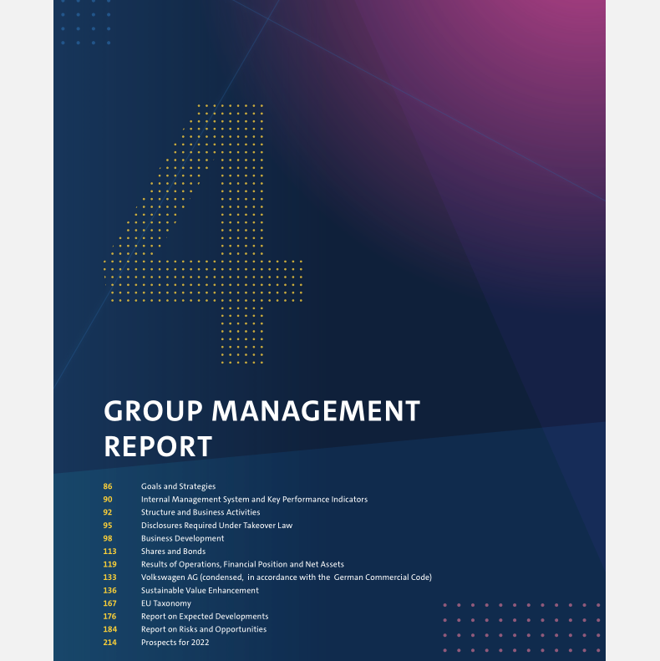
1. Context and type of analyses
2021 Report:
- Increase in sales
and operating result.
- Car+Financial Service.
- reduction of inventories (for sales) and new debt impacted "working capital".
- Less receivables.
- Acquisition of Navistar 3 Billion in Cash.
- High demand of financial service for used cars.
-Semiconductor shortage.
Current situation of the company:
- Growing?
- Profits? Why? Where?
- Looses? Why? Where?
- Risks?
- Future projects?
… Good starting point: managerial reports and financial analysis of industry experts.

Slide 15
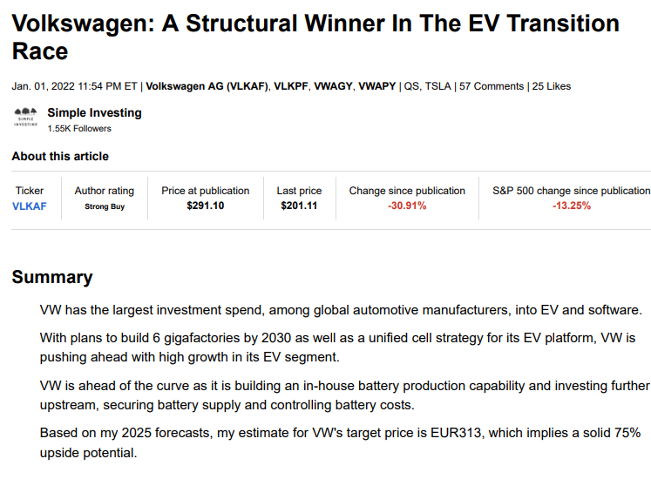
1. Context and type of analyses
Current situation of the company:
- Growing?
- Profits? Why? Where?
- Looses? Why? Where?
- risks?
- future projects?
… Good starting point: managerial reports and financial analysis of industry experts.

Slide 16
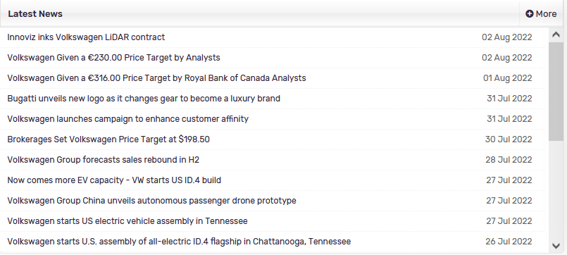
1. Context and types of analyses
More recent info?
Search for news in reputable sources.
The main goal is to detect important events that moved the company's economic situation.
Source
2. Liquidity, Debt, and Asset Mgmt
3. Return and Profitability
4. Stock Market

Slide 17
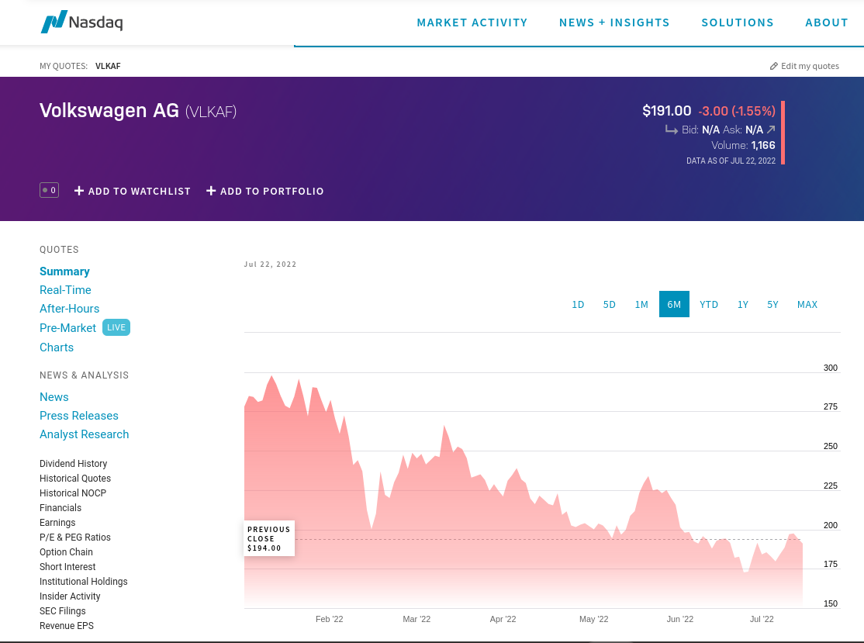
1. Context and types of analyses
Did the stock-market react to these events? If so, it is likely an important economic event.
2. Liquidity, Debt, and Asset Mgmt
3. Return and Profitability
4. Stock Market

Slide 18
1. Context and type of analyses
After having a clear perspective of the context, we can move to the quantitative analysis (also called financial analysis).
1) Comparison across time:
How is the company doing relative to previous years?
What has internally and externally changed?
internally: new CEO, new products, new production technology.
externally: changes in demand, stricter financing conditions.
2) Comparison within industry peers:
What explains cross-sectional differences?
different shocks
differences in efficiencies
differences in innovation or products
2. Balance Sheet
3. Income and Cash Flow Statement
4. Notes and Auditor Reports

Slide 19
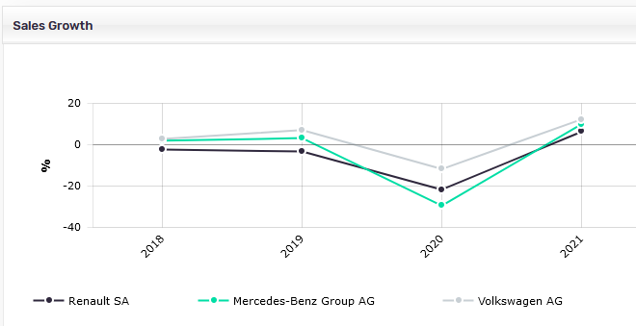
1. Context and type of analyses
2. Balance Sheet
3. Income and Cash Flow Statement
4. Notes and Auditor Reports

Slide 20
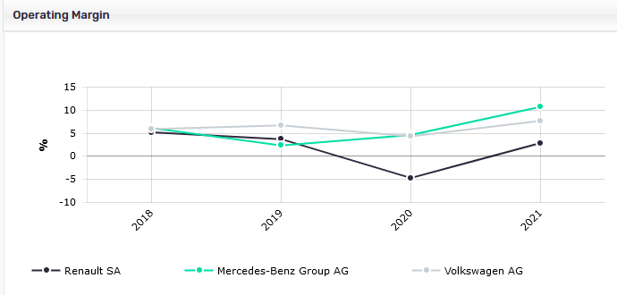
1. Context and type of analyses
2. Balance Sheet
3. Income and Cash Flow Statement
4. Notes and Auditor Reports
Notes:
Altough VW had superior growth on sales, it didnt capture the larger operating margin.
Mercedez seems to improve its operating efficiency. Renault no.
Why VW got relatively worse in terms of operating efficiency?
- inventories?
- too much cash?
- too much fixed assets?
What about financial efficiency?
This is the type of question we need to dig deeper in the following slides.

Slide 21
1. Context and type of analyses
Paid sources:
MarketLine (UPF Subscription, check the link in Library's website)
Bloomberg
SeekingAlpha.com
Free sources:
Yahoo Finance
MarketWatch.com
SeekingAlpha.com
2. Liquidity, Debt, and Asset Mgmt
3. Income and Cash Flow Statement
4. Notes and Auditor Reports

Slide 22
1. Context and type of analyses
2. Liquidity, Debt, and Asset Mgmt
1) Component
Balance sheet elements as a percentage of Total Assets.
(1) Is the company growing? Total assets, Annual growth, CAGR.
(2) How are current assets distributed? Is any new type of assets in the company?
(3) How are current liabilities distributed? Is any new type of funding?
(4) Equity: new emissions? Positive retained earnings?
2) Ratios and Measures
(1) Liquidity: does the firm have enough liquidity to meet its financial obligations when they should be paid?
(2) Debt level or Solvency: does the firm have too much debt? Can it pay it in the long-term?
(3) Asset management: how efficient is the company in using its assets to produce sales/revenues?
3. Income and Cash Flow Statement
4. Notes and Auditor Reports

Slide 23
1. Context and type of analyses
2. Liquidity, Debt, and Asset Mgmt
2) Ratios and Measures
Liquidity
Debt
Assets
Working Capital
Liabilities
Liabilities+Equity
Sales
FA turnover
FA
WK: CA-CL
WK needs/operative:
WK - (Other CA-Other CL)
CA
Current R.
CL
Debt
Sales
CA turnover CA
CL
Quality
Liabilities
CA – Inv.
Liquidity
CL
Days
Fin. expenses
Sales
Inventories
Daily cost of sales
Receivables.
Days Rec.
Daily Sales²
Financial
Expenses
Stock days
Cash
CL
Payables.
Days Pay.
Daily COGS
Cash Cycle = DR+SD- DP
Acid test
Cash flow
Total Loans
Return
capacity
¹: for a growing firm, use the average value in the balance sheet ítems for ratios that also need info from the income statement.
²: it is better to use "sales on credit", but this item is rarely reported.
3. Return and Profitability
4. Notes and Auditor Reports

Slide 24
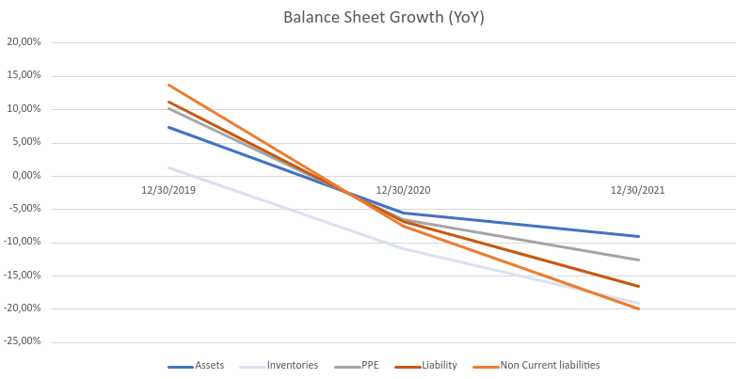
1. Context and type of analyses
2. Liquidity, Debt, and Asset Mgmt
3. Return and Profitability
4. Notes and Auditor Reports
Notes:
VW: Significant increase in all liquidity metrics, while for MB they are quite stable.
Potential reasons? MAYBE WRITE THEM OUT ON THE WHITEBOARD!
- is VW foreseen intensive investment expenses? Saving cash from profits or new debt.
- does VW have debt payments son?
- did VW receive fresh capital from shareholders?

Slide 25
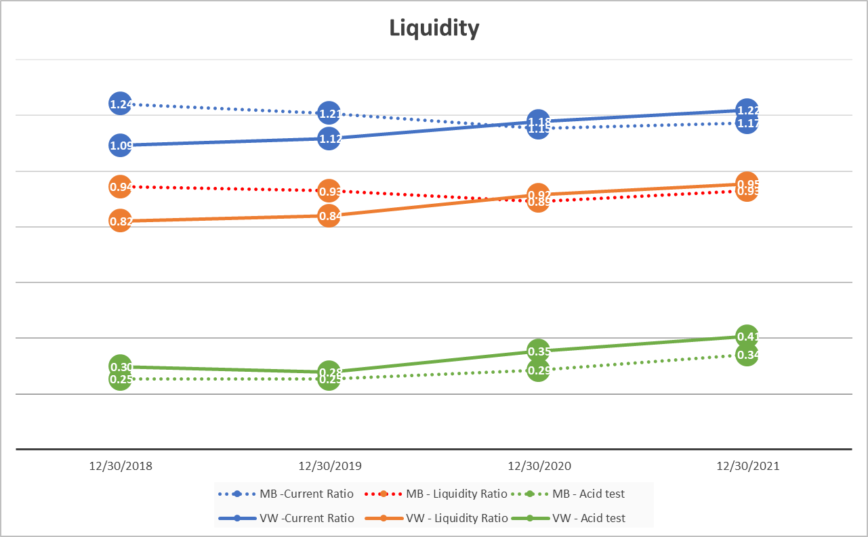
1. Context and type of analyses
2. Liquidity, Debt, and Asset Mgmt
3. Return and Profitability
4. Notes and Auditor Reports
Notes:
VW: Significant increase in all liquidity metrics, while for MB they are quite stable.
Potential reasons? MAYBE WRITE THEM OUT ON THE WHITEBOARD!
- is VW foreseen intensive investment expenses? Saving cash from profits or new debt.
- does VW have debt payments son?
- did VW receive fresh capital from shareholders?

Slide 26
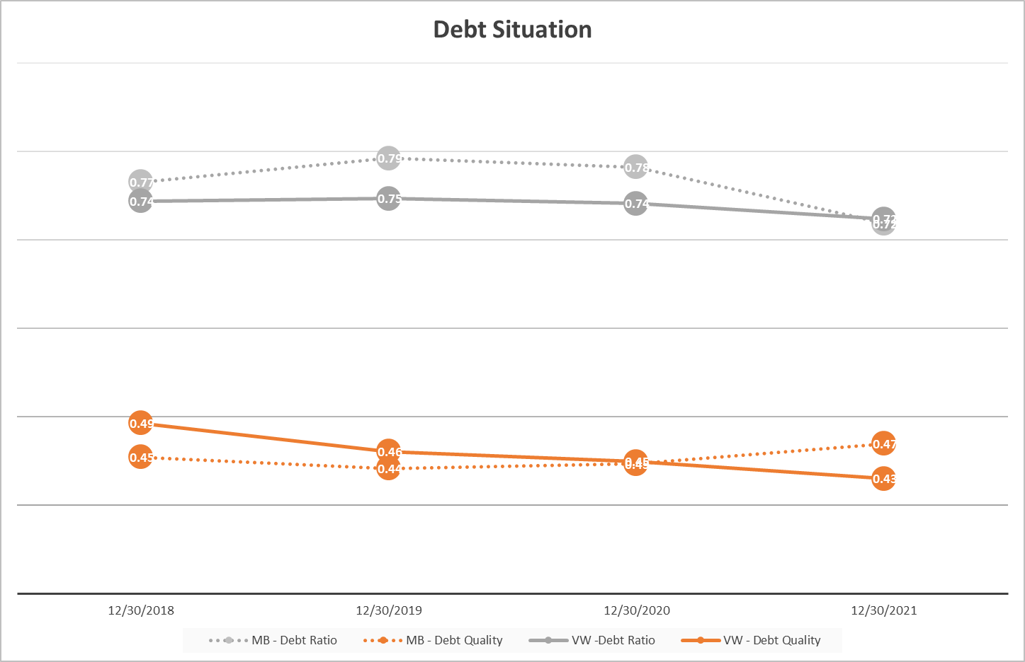
1. Context and type of analyses
2. Liquidity, Debt, Asset Mgmt
3. Return and Profitability
4. Notes and Auditor Reports
Notes:
VW' debt ratio (amount) is stable, so no it does not seems that the better liquidity comes from "new debt."
VW' debt quality is consistently decreasing across time…. So it is not seen increases in "debt payments." in the short term.

Slide 27
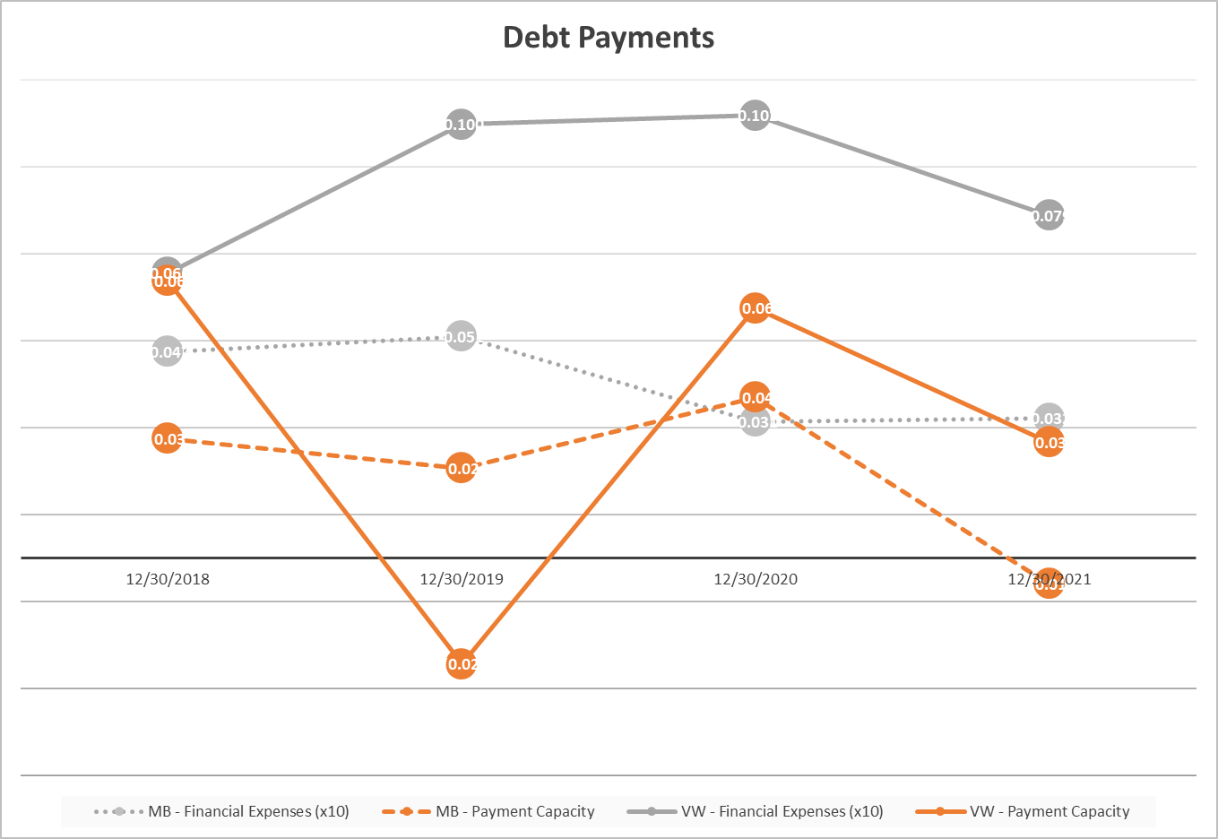
1. Context and type of analyses
2. Liquidity, Debt, and Asset Mgmt
3. Return and Profitability
4. Notes and Auditor Reports
Notes:
VW: the reduction in debt is consistent with the reduction in financial expenses.
In terms of payment capacity, both companies have faced an important reduction, driven by the contraction of cash flows in 2021, more because of cash Flow reduction rather than for increase in total debt!

Slide 28
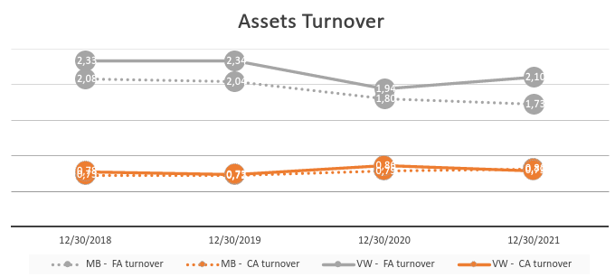
1. Context and type of analyses
2. Liquidity, Debt, and Asset Mgmt
3. Return and Profitability
4. Notes and Auditor Reports
Notes:
While both companies have similar CA turnover, VW has almost 20pt of better FA turnover, so they are more efficient at using its fixed assets to generate revenues.

Slide 29
1. Context and type of analyses
2. Liquidity, Debt, and Asset Mgmt
Assets
Equity + Liabilities
Assets
Equity + Liabilities
Equity
Fixed
Assets
Fixed
Assets
Real
Working
capital
Equity
LT
Debt
Current
Assets
Current
Assets
ST
Debt
ST
Debt
3. Return and Profitability
4. Notes and Auditor Reports
Notes:
Should I change "debt" for liability, to avoid confusión?

Slide 30
1. Context and type of analyses
2. Liquidity, Debt, and Asset Mgmt
Working capital is a dimension of a company’s operational efficiency and short-term financial health, so it mixes both liquidity and asset management.
large WC: the potential to invest in expansion and grow the company.
small or negative WK: current assets do not exceed its current liabilities. This may lead to trouble growing or paying back creditors.
Longer production cycles require higher working capital needs: slow inventory turnover to generate cash on demand.
But how can we differentiate the observed working capital from the actual working capital needs?
Difficult, but we can proxy by removing non-essential current liabilities and assets.
be aware, in practice, not always these items are reported separately, so you can do the best you can with the data available.
3. Return and Profitability
4. Notes and Auditor Reports
Notes:
VW has a real wk just a bit above the required… a SURPLUS in WK.
MB is in deficit of WK

Slide 31
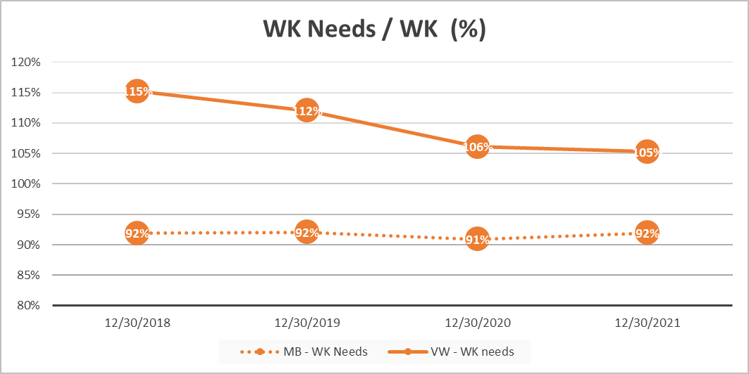
1. Context and type of analyses
2. Liquidity, Debt, and Asset Mgmt
3. Return and Profitability
4. Notes and Auditor Reports
Notes:
VW has a real wk just a bit above the required… a SURPLUS in WK.
MB is in deficit of WK

Slide 32
1. Context and type of analyses
2. Liquidity, Debt, and Asset Mgmt
BUSINESS CYCLE
Raw materials
Works in progress
Finished goods
Clients
R.M. Purchase
Start of production
End of production
Sales
Customers payment
Operating cycle
CASH CYCLE
R.M. purchase
Suppliers
payments
Sales
Customers payment
Raw materials
Works in progress
Finished goods
Customers period
Suppliers periods
Cash cycle
Operating cycle
3. Return and Profitability
4. Notes and Auditor Reports

Slide 33
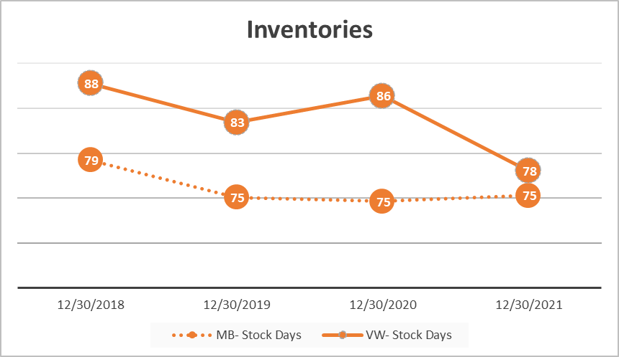
1. Context and type of analyses
2. Liquidity, Debt, and Asset Mgmt
3. Return and Profitability
4. Notes and Auditor Reports
Notes:
VW improves drastically the speed for selling inventories in 2021, reaching similar levels than MB.
Maybe online selling?

Slide 34
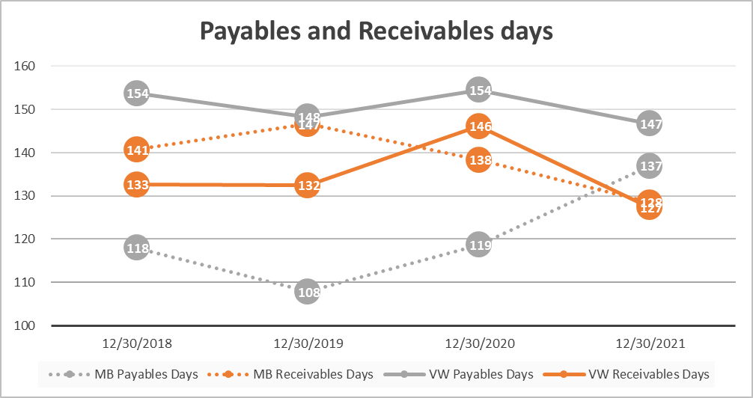
1. Context and type of analyses
2. Liquidity, Debt, and Asset Mgmt
3. Return and Profitability
4. Notes and Auditor Reports
Notes:
VW: Orange: the company had problems collecting during 2020, but seems to recover in 2021. The company also took longer to pay payables during 2010 and again is in shape.
MB: the lines crossed each other, but that is a good sign, since before the company, on average, was taking longer in collecting receivables than in paying its commercial obligations.

Slide 35
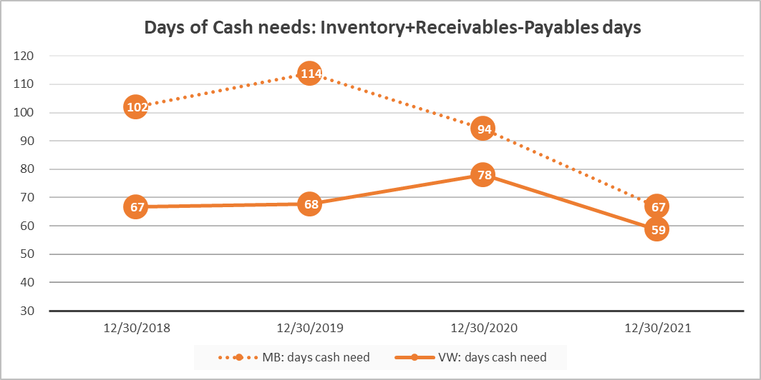
1. Context and type of analyses
2. Liquidity, Debt, and Asset Mgmt
3. Return and Profitability
4. Notes and Auditor Reports
Notes:
VW must invest cash in its operating activities for just over 59 between the time it pays its suppliers and the time it collects payments from its customers.
MB has decreased this number by delaying paying suppliers.
Companies prefer to minimize the time between paying vendors and collecting cash from customers because it frees up cash for other productive purposes.
VW could reduce this time by slowing payments to creditors or by increasing how quickly it turns over its inventory

Slide 36
1. Context and type of analyses
2. Liquidity, Debt, and Asset Mgmt
Main conclusions for 2020-2021:
Liquidity Management:
Significant increase in most of the liquidity metrics.
Debt Management:
Stable and moving to Long term.
Assets Management:
Improves in Current efficiency, not in Fixed Assets efficiency.
Working Capital Management
Faster cycles (inventories, payables, receivables), leading to shorter cash needs.
Limited working capital surplus.
The competitor is more efficient with its Fixed assets.
3. Return and Profitability
4. Notes and Auditor Reports
Notes:
Summary,
The increase in sales in the industry has been well captured by VW, which increased annual sales and operative margins. At the same time, the higher efficiency in the business cycle (faster inventory turnover and cash collection) enable VW to gain liquidity. So even though the company is investing intensely in acquiring companies and EVs, it is in good liquidity and solvency situation, so the investment is not threatening its financial situation.

Slide 37
A good analysis does not describe only the trend or change, but also the reasons behind. Remember business background, MD&A.
1. Context and type of analyses
2. Liquidity, Debt, and Asset Mgmt
Practical Recommendations for pursuing your analysis:
Where should we start the analysis?
There is no rule of thumb, but in my experience, the analyses flow better with the following structure:
1) firm growth (and trend).
2) describe the assets triggering the growth (more inventories? more cash? New plants or equipment?)
2.1) connect this point with the qualitative analysis done before: industry, trends, competitions, new products, change of strategy, etc.
3) describe how the growth is being funded (important changes in the funding structure?).
4) finally, explain the impacts on the ratios.
But... there are multiple reaons!
Yes, but in many cases it is just one or two events driving most of the effect... and we should know them.
3. Return and Profitability
4. Notes and Auditor Reports
Notes:
About 2.1, it is important to highlight that the qualitative analyses we did was broad and fast… it takes months for analysts to become experts in an industry… they need to know far more details about technologies, investment, careers, etc. We just developed a working understanding of the issue.

Slide 38
1. Context and type of analyses
2. Liquidity, Debt, and Asset Mgmt
Practical Recommendations for pursuing your analysis:
Good:
“A further analysis of Apple and Samsung noted that Samsung
showed a growth in their goodwill of 23.11% between 2014 and
2015. This increase of 23.11% increase was mainly due to
Samsung's acquisition of YESCO Electronics LLD. This reflects
the idea that it is not the number of companies acquired by a
company that makes a difference, but the quality of these
companies considering their intangible assets.”
Vague
Samsung’s balance sheet indicates that total assets of the company have been growing for the last 5 years in a constant way: there was a growth peak in 2011 (24.9% increase), and since then there has been a gradual deacceleration of this growth (although there was never a decrease)
3. Return and Profitability
4. Notes and Auditor Reports
Notes:
Remaining questions:

Slide 39
1. Context and type of analyses
2. Liquidity, Debt, and Asset Mgmt
General Managerial Recomendations (not related to VW):
Liquidity Management:
creditors policy and debt collection strategy.
Debt Management:
social capital.
Assets
Production and inventory strategies: JIT, Kaizen.
Working Capital Management
Working capital needs: how much? How long?
cash-oriented sales promotion… is it worth sacrificing profitability?
purchase agreements with providers.
renegotiation short-term debts
debt to equity conversión (… uf!)
promote long-term projects that are cash generators (even though no so profitable)
renegotiate debt contract (better interest rates now in the market?)
Technology to improve information reporting
Asset sales or offsourcing
Closely related to liquidity and asset management.
3. Return and Profitability
4. Notes and Auditor Reports

Slide 40
2. Liquidity, Debt, and Asset Mgmt
3. Return and Profitability
1. Context and type of analyses
Assets
Turnover
Sales
Financial
Leverage
ROI (ROA)
Margin
Equity
Profit
ROE
EPS
4. Notes and Auditor Reports

Slide 41
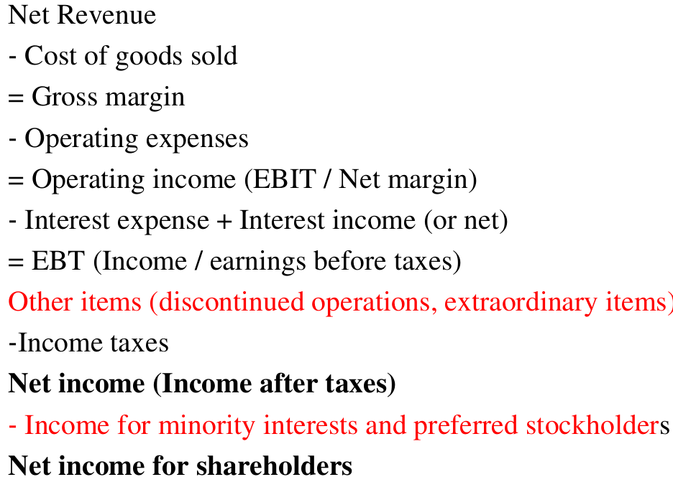
2. Liquidity, Debt, and Asset Mgmt
3. Return and Profitability
1. Context and type of analyses
The data for the profit analyses come from the income statement.
The general rule is to focus only on the results driven by ordinary activities: normal operations, and normal financing.
Important items to consider/clean:
- "extraordinary items" are unusual and infrequent events that might have generated gains or losses, for example, sale of fixed assets or asset re-evaluation.
- "Discontinued operations": operations that the company has sold or abandoned. Their profit/losses must be explicitely separated from the other items.
4. Notes and Auditor Reports

Slide 42
2. Liquidity, Debt, and Asset Mgmt
3. Return and Profitability
1. Context and type of analyses
Point of view of an Investment performance:
Company ROI, MARGIN
Shareholder ROE, EPS
Return on equity (ROE) =
Net Income
Equity
Net Income
Nº Common Shares O.
Earnings per Share (EPS) =
Return on investment (ROI) =
EBIT
Net total assets
Marging =
Net Income
Sales
4. Notes and Auditor Reports

Slide 43
2. Liquidity, Debt, and Asset Mgmt
3. Return and Profitability
1. Context and type of analyses
Return breakdown
Net profit
Equity
ROE = =
Net profit Sales Assets
Equity Sales Assets
ROE = x x =
Net profit Sales Assets
Sales Assets Equity
ROE = x x =
ROE = Margin x Turnover x Financial leverage
4. Notes and Auditor Reports

Slide 44
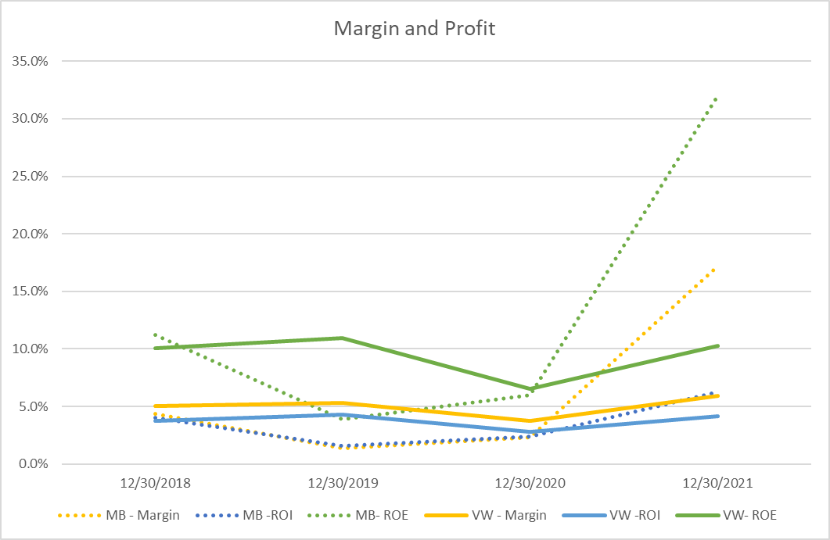
2. Liquidity, Debt, and Asset Mgmt
3. Return and Profitability
1. Context and type of analyses
4. Notes and Auditor Reports
Notes:
VW has a stable margin, around 5% even during covid, this says how flexible is its production technologies. MB too but its margins hit above 15% in 2021.
For VW both returns, ROA and ROE are also quite stable around 2-5% since 2018.
The reason why MB has such a Good performance is because the change their strategy: top luxury cars rather tan entry luxury car. So they focus on more on profitability than in volumen.

Slide 45
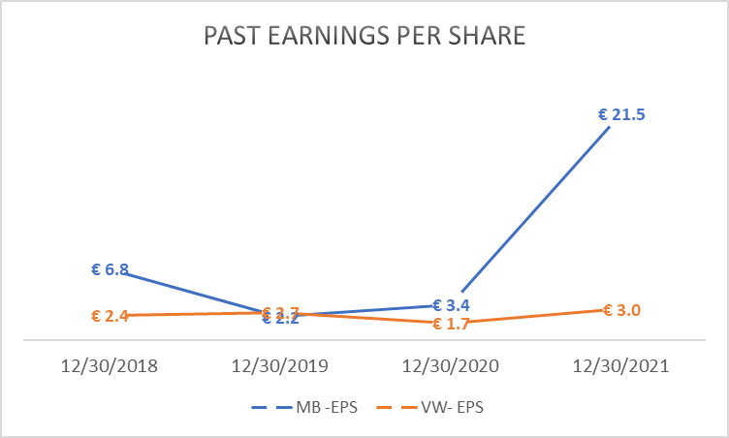
2. Liquidity, Debt, and Asset Mgmt
3. Return and Profitability
1. Context and type of analyses
4. Notes and Auditor Reports
Notes:
EPS is $3, the better in the last 3 years, but way below MB.

Slide 46
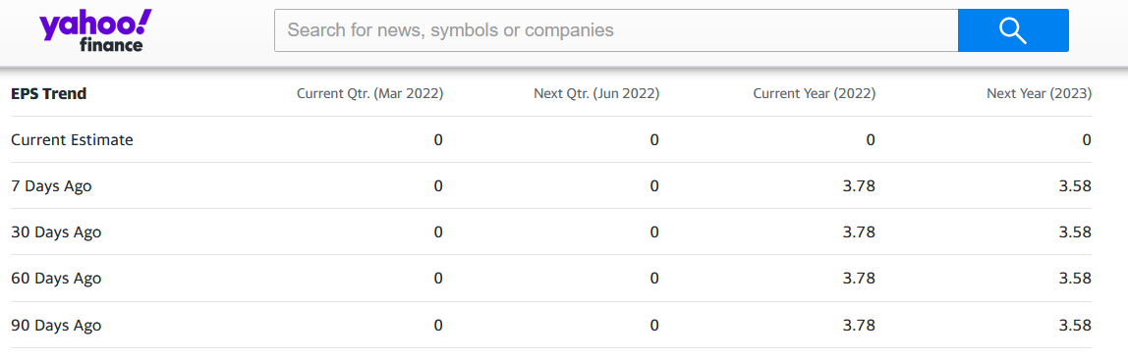
2. Liquidity, Debt, and Asset Mgmt
3. Return and Profitability
1. Context and type of analyses
4. Stock Market
Notes:
EPS is one of the main variables observed and predicted in the financial market.
For 2022, the market is expecting an increase in EPS to 3.78, and then a decrease to 3.58.

Slide 47

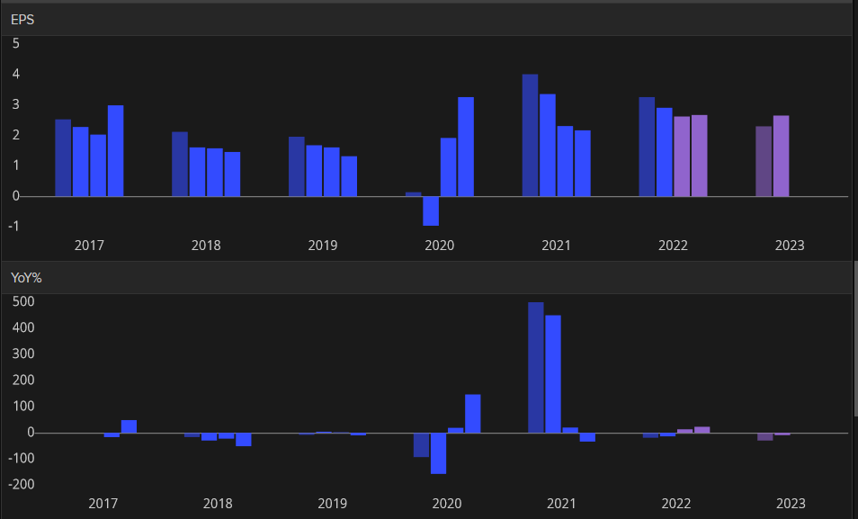
2. Liquidity, Debt, and Asset Mgmt
3. Return and Profitability
1. Context and type of analyses
4. Stock Market
Notes:
In purple the mean prediction from analyst for 2022 and 2023

Slide 48
3. Return and Profitability
4. Stock Market
2. Liquidity, Debt, and Asset Mgmt
1. Context and type of analyses
Price/Earnings (PE) Ratio: (Market Price per share) / (Earnings per share)
The value of a stock is determined by calculating the present value of the company’s future earnings.
Dividend Yield Ratio: (Dividend per share) / (Market Price per share)
While a high P/E ratio and good growth prospects are considered favorable, there are risks.
A high ratio indicates that earnings are expected to grow rapidly.
Remember 2 sources of gains for investors:
Dividends and stock price appreciation.
Companies with growth prospects can provide more gains to investors by re-investing (R&D) profits rather than distributing dividends.
Notes:
When investors buy stock, they can earn a return on their investment through dividends or price appreciation. The dividend yield ratio reflects the return on investment absent any capital appreciation, or, said differently, the return attributed solely to the dividends a company pays. Not all companies report the cash dividend they paid per share on their income statement or statement of cash flows, so you may need to search their 10-K to find the information.

Slide 49

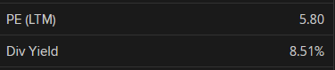
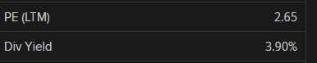
3. Return and Profitability
4. Stock Market
2. Liquidity, Debt, and Asset Mgmt
1. Context and type of analyses
Precio/Earnings (PE) Ratio: Market Price per share / Earnings per share
Dividend Yield Ratio: Dividend per share / Market Price per share
Notes:
The market is expecting more earning growth in Mercedes, and also, that company is paying more dividends.

Slide 50
3. Return and Profitability
4. Stock Market
2. Liquidity, Debt, and Asset Mgmt
1. Context and type of analyses
Profitability
Stock Market valuations
Stable margin and returns in the last years.
Competitor had a significant increase in most of the metrics.
EPS increased to above 3% and the forecast does not seem show big changes
PE ratio suggests that the market is expecting some growth,
but less than the competitor. Consistent with its improved margins and returns.

